Slide 1

Pressure, Priorities, and Peace:
Managing Stress in the Practice of Law
Erin Boryczka
and
Jack T. Carney
Committee Member, Alabama Lawyer Assistance Program

Slide 2

Your Speaker
Erin Boryczka
17 years managing a small law firm
20 years experience managing a small business
Managing a household – Mother of 3 Children
Disclaimers:
I am not a counselor or therapist
The contents of this presentation represent my own experiences and are not official pronouncements of the Alabama State Bar or the Alabama Lawyer Assistance Program
Notes:
A seminar never caused lasting change in my life (much like a sermon). It is our experiences and usually pain that causes change. My hope is that something I say today will resonate with your own personal experiences and spark some type of positive change in your life.

Slide 3

The Law is Stressful
In 2018, Jack spoke to his daughter’s third grade class about having a career as a lawyer. He tried to inspire them and spoke about the many benefits that lawyers provide to our community, including:
  Peacefully resolving disputes
  Helping people get benefits
  Protecting rights
  Protecting public safety
  Etc., etc., etc.

Slide 4
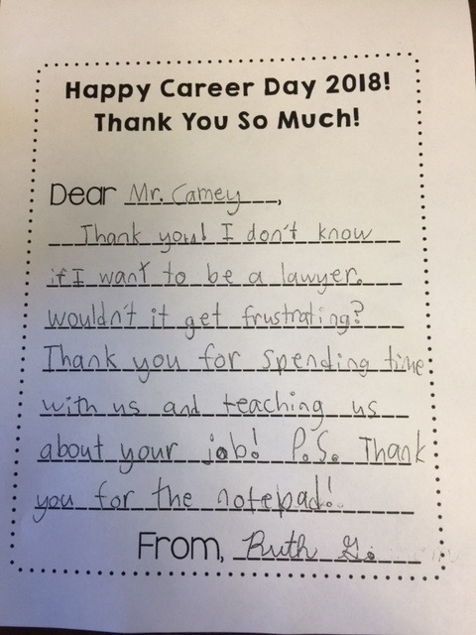
The Law is Stressful

Slide 5

The Law is Stressful
A 2023 ABA Survey found that 71% of attorneys experienced anxiety (up 5% from the prior year)
Lawyers claiming to experience depression was up 3% to 38%
50% of lawyers felt a feeling of failure or self-doubt
60% of lawyers feel overwhelmed, irritable and exhausted
https://www.abajournal.com/news/article/mental-health-initiatives-arent-curbing-lawyer-stress-and-anxiety-new-study-shows#google_vignette

Slide 6
The Law is Deadly
The National Institute of Health found that 10-12% of attorneys have contemplated suicide. Compare that to 4.2% of the general population.
https://pmc.ncbi.nlm.nih.gov/articles/PMC9956925/
A Psychology Today article found that lawyer suicides are 91% more likely to be related to job stress than other reasons for suicide.
https://www.psychologytoday.com/us/blog/psymon-says/202304/why-are-lawyers-at-greater-risk-of-suicide

Slide 7
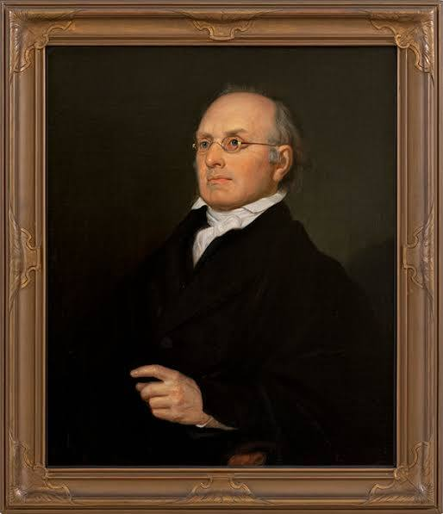
The Practice of Law Takes Commitment
“[The Law] is a jealous mistress, and requires a long and constant courtship. It is not to be won by trifling favors, but by lavish homage.”
Justice Joseph Story, 1835

Slide 8
Breaking News!
On September 10, 2026 the ABA released the results of the ABA/Krill mental health study.
The results show an increase in rates of burnout and the risky use of alcohol as a coping mechanism.
You can access more information here:
https://www.americanbar.org/news/abanews/aba-news-archives/2026/09/new-lawyer-mental-health-study/

Slide 9
Breaking News!
47.4% of lawyers screened positive for high burnout
15.6% were positive for severe burnout
20.5% reported increased use of drugs or alcohol related to professional stress
57% reported seeing mental health or substance abuse problems in their colleagues
35.9% reported high conflict between their personal and professional lives

Slide 10

Chronic Stress Leads to Burnout
“A little bit of stress is good and can help us perform daily activities. Too much stress can cause physical and mental health problems.”
https://www.who.int/news-room/questions-and-answers/item/stress
“Burnout is a state of emotional, physical, and mental exhaustion caused by prolonged or excessive stress. It’s not simply feeling tired after a long day, but a deep sense of disillusionment and cynicism that can erode one’s sense of accomplishment and motivation.”
https://www.michbar.org/journal/Details/Recognizing-and-combatting-lawyer-burnout-A-guide?ArticleID=4877

Slide 11

Signs of Stress and Burnout
Declining productivity and quality
Missing work
Tardiness
Difficulty concentrating
Changing habits
Neglecting social activities
Expressing hopelessness
https://www.michbar.org/journal/Details/Recognizing-and-combatting-lawyer-burnout-A-guide?ArticleID=4877

Slide 12
Causes of Burnout
Workload and long hours
Demanding clients
Lack of control
Competitive work environment
Lack of social structure and support
https://www.michbar.org/journal/Details/Recognizing-and-combatting-lawyer-burnout-A-guide?ArticleID=4877

Slide 13
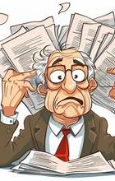
Under Pressure
Let’s look at the pressure points in each of the three basic parts of any law practice:
1. Getting the Work
2. Doing the Work
3. Billing the Work

Slide 14

Getting the Work –
The 3 Step Screening
Can I do it (or can I learn to do it)?
Do I want to work with this client?
Will I get paid?

Slide 15
Getting the Work
Mental Barriers to Effective Rainmaking
Lack of self-confidence
  Rebuttal – The ASB says you are fit to practice law, so do it! There are resources available to help.
Fear
Rebuttal – Look at the facts, not fear.
Perfection
Rebuttal – It does not have to be perfect and
that’s fairly subjective anyway.

Slide 16
Getting the Work- Practice Tip Stress Reducer
The Engagement Agreement
Create a strong attorney-client relationship from the start with a well written engagement agreement.
It lowers your risk of bar complaints or malpractice complaints.
It defines your scope to prevent “scope creep.”
It sets the tone for billing the client.
Remember, many problems with a case do not develop as the case goes on, but rather they started from the day the attorney accepted the case .

Slide 17
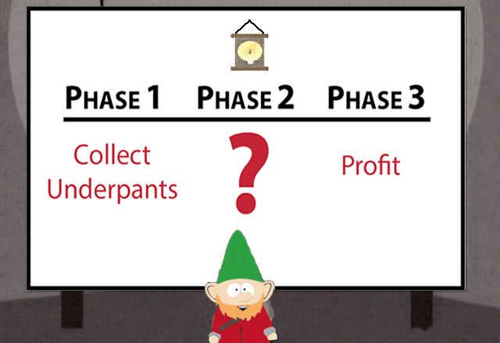
Doing the Work
Many attorneys know how to get the work (good rainmakers). They may even know how to bill effectively and get paid for the work, but it is the process of getting the work complete that is problematic.

Slide 18

Doing the Work - Operations
Develop Systems to create predictability, efficiency, and minimize mistakes that lead to stress.
Ask for Help- If you are stressed and anxious, it is a clue that you are outside of your comfort zone- and in the practice of law you will be outside your comfort zone.
Delegate, Delegate, Delegate
Communicate with clients in a timely manner to prevent disputes.

Slide 19

Doing the Work -Overwhelmed
Fighting Executive Dysfunction
Brain dump- avoidance is unhealthy; write down all the things you need to do.
One action at a time.
Use another person’s function (like a gym buddy) to hold you accountable.
Set external timers or reminders to prompt your next task.

Slide 20

Doing the Work – Energy Management
Manage your energy, not your time.
Article:Manage-Your-Energy-Not-Your-Time.pdf
Consider the true cost of trying to manage your time (it takes time and causes stress).
Practice saying “no” – The same decisions and habits cause the same results. You have to change your decisions and habits to keep you from being stuck and burned out.

Slide 21
Doing the Work – Energy Management
Consider “de-cluttering” your task list. You cannot truly clean your room if there are too many items in it.
There is no perfect time management system.
Resist the urge to just “do one more thing.” Attorneys especially get caught in the mindset that if they just work harder, things will eventually become more manageable.
Practice tip – Jack stopped working at night because he was not effective. He turned it off until the AM and did the same task in 25% of the time it would have taken the night before. Less mistakes are also made.

Slide 22

Be Mindful of The Dump and Compassion Fatigue
Clients Dumping on Lawyers
Clients can’t express frustration to the courts, adverse parties, etc.
You can handle trauma dumping better if you are not stressed.
You are Asked to Fix Emotional Problems
Compassion fatigue can alter your well being.
Cultivate resilience by talking to trusted colleagues and recognize what you can control and what you can’t.

Slide 23

Doing the Work –
Practice Tip
Out of time? Buy some back!
  Yard work
  Child care
  Housecleaning
  Meal prepping
  Office related – Jack does not need to copy things. He does not need to make coffee or run office errands.
  Make good use of your time. Avoid the mentality to not pay for anything!

Slide 24

Billing the Work
Create policies that will guide you.
Be upfront with clients to reduce disputes and keep happy clients.
Bill consistently. If you do not bill timely, you might not collect!
Lack of communication with clients many times begins the dispute.
Address failure to pay quickly!
Put your time in daily. It is 2026 – the tools to help you exist! This is still part of Doing the Work.

Slide 25
Billing Practice Tips
Hire Help! The same system that caused the problem is not capable of solving it.
When Jack hired a contract worker to address his billing, it changed everything.
Use your time for billable work. Leverage your team.
Remember, you are not a bank!
Do no let your accounts receivable bring added stress to your practice.

Slide 26
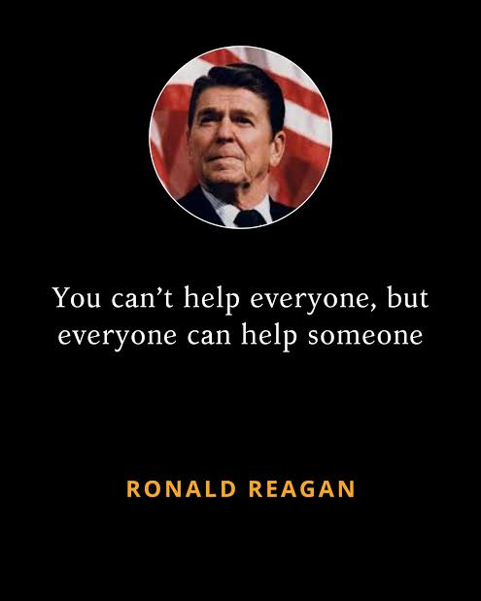
You Can’t Help Everyone…..
Referring people to organizations such as a Volunteer Lawyers program is a win-win for clients and the non-profit organization.
When you refer people to Volunteer Lawyers.
-Your firm gets credit.
-You use their system and insurance.
-They screen the client.
-The program gets credit for hours.
-You can ask the VLP to send them to you.
-You can more easily terminate the representation.

Slide 27

Priorities
What do you say your priorities are?
-Family?
-Faith?
-Career?
What does your calendar say about your priorities?
What does your bank account say about priorities?
You can tell what is important to someone about how they spend their time and their money.
Where you put your treasure, there your heart will be.

Slide 28
Priorities
If I can just catch up- then I’ll do x ….
Do I over-identify with the profession- why?
If money was no object- what would you do?
If you learned that you had one year to live, what would change?
We have all these priorities in life, but where do we put ourselves? If we are not looking out for ourself, then who is?

Slide 29
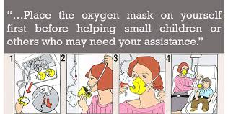
Self-Care
People who are “helpers” need to ensure that they take care of themselves first before helping others

Slide 30
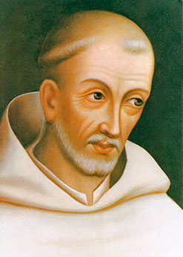
Self-Care
“The man who is wise, therefore, will see his life as more like a reservoir than a canal. The canal simultaneously pours out what it receives; the reservoir retains the water till it is filled, then discharges the overflow without loss to itself.”
Bernard of Clairvaux (1090-1153)

Slide 31
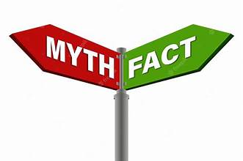
Self-Care Myths
MYTH - Self-care is selfish
  FACT - Self-care is essential
MYTH - Self-care will take too much time
  FACT - Five minutes of care many be sufficient
MYTH - Self-care is expensive
  FACT - Most of the best self-care activities are free

Slide 32

Self-Care Examples
The basics:
-Sleep
-Food
-Water
-Family and social connections
-Spirituality

Slide 33

Self-Care Examples
Self-care (graduate level)
-Physical Activity
-Meditation
-Hobbies
-Solitude (not isolation)
-Reading and journaling
-Travel
-Spend time on professional development

Slide 34
Self-Care versus Self-Indulgence
Self-Indulgence can include:
  Overeating
  Oversleeping
  Binge watching
  Drugs and Alcohol
  Pornography
  Doomscrolling on Social Media
Self-indulgence is using something or someone to change how you are feeling, whereas self-care is you taking action to change how you feel. Self-care is an investment that has longer lasting, positive results. Self-indulgence leads to shame and regret.

Slide 35
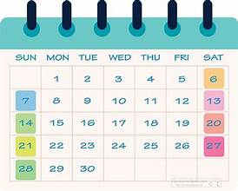
Self-Care
Practice Tips:
Be intentional and schedule your self-care and treat it like a client appointment (that is honor it like you would honor a commitment you would make to another person).
Be creative and experiment with different types of self-care activities.

Slide 36

Boundaries
What are the threats to our boundaries?
Overcommitment - it is rewarded in the law, starting with law school.
https://www.psychologytoday.com/us/blog/psymon-says/202304/why-are-lawyers-at-greater-risk-of-suicide
- Tying our worth to our work

Slide 37
Boundaries
What is a boundary?
“[Boundaries] define what is me and what is not me. A boundary shows me where I end and someone else begins, leading me to a sense of ownership.”
Cloud & Townsend, Boundaries, page 31
Notes:
What an interesting question for a lawyer! Many of us deal regularly with boundaries and disputes regarding the same.

Slide 38

Boundaries
You are responsible for setting a boundary and responsible for maintaining a boundary.
Whenever you set a boundary, you will always receive pushback.
No one will thank you for setting a boundary!

Slide 39

Boundaries
Practice tips:
Practice saying no
Beware of the words “just” and “quick”
Pause before answering any request
Buy this book:

Slide 40

Seeking Peace
Prioritize what’s important to you
Prioritize self-care
Prioritize time management
Prioritize boundaries
Prioritize your message and do not mirror the “show” around you. Cultivate patience and emotional intelligence and do not let pride and emotion take over.

Slide 41
Seeking Peace
Practice Gratitude! It literally is a brain changer. It nurtures resilience, boosts self- confidence as a practitioner, and can bring you a renewed sense of purpose.
True Peace – Recognizing and Accepting Enough!
"We can never get enough of what we don't really need.“
-Matthew Kelly

Slide 42
Obstacles to Help
-Fear of appearing incompetent- the Rules of Professional Conduct require lawyers to provide competent representation and an attorney may fear asking for help may demonstrate a violati0n of this rule.
-Since law school, your success is based on your own efforts. Lawyers are trained to “go it alone.” Law school was competitive. Big firms can be competitive
-Asking for help involves surrendering some control, which is usually difficult for attorneys.
https://www.attorneyatwork.com/asking-for-help/ (accessed September 27, 2026)

Slide 43
Obstacles to Help
-We all have biases and prejudices, some instilled from childhood, such as “mental health counseling is for the weak” or “we don’t let people know we do not have it together.”
-There is also a lot of ignorance and unfounded fear associated with asking for help. In the recovery world, they call this contempt prior to investigation.
-But true competence and diligence is asking for help when needed!

Slide 44

Resources
The Alabama Lawyer Assistance Program (ALAP)
https://www.alabar.org/programs/alabama-lawyer-assistance-program/

Slide 45
Other Resources
Counseling (the Alabama State Bar will provide resources!)
Law Practice Management Program https://www.alabar.org/programs/lawpracticemanagement/)
Apps (Headspace, Insight Timer)
12 Step Recovery Programs
Alanon
Church and Spiritual Centers

Slide 46
Other Resources
Bar associations and other opportunities for connection
Books
Podcasts
Note- when we want to be physically healthy, we eat right, work out, hire a trainer, etc. But what do we do for mental and emotional health?

Slide 47

Warning About AI
Artificial Intelligence (AI) may not be the help you need, especially if you do not use it appropriately in your practice .

Slide 48
For Questions and Confidential Assistance
Alabama Lawyer Assistance Program
Phone number: (334) 224-6920 or (334) 517-2216
Jack Carney
  Personal e-mail: jackcarneyesq@gmail.com
  Cell phone: (205) 276-6250

